Slide 1
Wessex Volleyball Club
AGM 2020
Thursday 17th September, 19:30
PLEASE GO ON MUTE WHEN YOU ARE NOT PARTICIPATING IN THE EVENT!

Slide 2
AGM Agenda
Matters arising from 2019 AGM
Officer Reports
Chairperson – Dave Gunter
Treasurer – Peter Lambert
Welfare Officer – Michelle Honeybun
Acting Secretary – Dan Hunter
Junior Development Officer – Annetta Minard
Co-opted Member – Anthony Robert
Election of officers to the board
Chairperson
Treasurer
Secretary
Non-Board Positions
Social and Event Secretary
Fund Raising Officer
Marketing Officer
AOB
Notes:
Club info 2020-21 season
COVID Guidelines - Club Survey report – Season 2020-21 - Rebrand and new kit reveal – Q and A

Slide 3
Matters of 2019 AGM
Dave Gunter
https://www.wessexvolleyball.com/club-meetings

Slide 4
Chair Person Report
Dave Gunter

Slide 5
2019-20 Results
Women Super League – 3rd place
Men Super League – 6th place
Women 2 (NVL2S) – 5th place
U18 Men – 5th
U18 Women – 9th
U16 Boys – 3rd
U16 Girls – 9th
U15s – last 8s cancelled due to COVID-19
South West Grand Prix Events
Wessex Dolphins (U12 Boys) – 1st
Wessex Sharks (U14 Girls) – 2nd
Wessex Orcas (U15 Boys) – 1st
Athletes selected to represent South West, England (Cadets, Juniors and Seniors) on the indoor and beach

Slide 6
Club Management Structure
CHAIRPERSON
Dave
CO-OPTED
Anthony
VICE CHAIR
Dan
TREASURER
Peter
CO-OPTED
Colin
Club Board
CO-OPTED
Wayne
JUNIOR DEVELOPMENT
Annetta
WELFARE
Michelle
SECRETARY
Dan (Acting)
HEAD OF COACHING
Future Post
COMMERCIAL OFFICER
Vacant
SOCIAL AND EVENTS
Vacant
FUNDRAISING OFFICER
Vacant
MARKETING OFFICER
Vacant
Club Mgt
Team Mgt
HEAD COACHES, ASSISTANT COACHES, TEAM MANAGERS, TEAM SECRETARIES ETC
https://www.wessexvolleyball.com/club-board

Slide 7
Progress from 2019 AGM
Strategic plan
Welcome pack / handbook
Super Saturdays
Establish Men 2 team for 2020-2021 Season
Work towards becoming a cash less club
Integrate new coaches into coaching team
Run a club coaches workshop
Develop job roles further
More people doing less rather than a few doing lots
Increase participation in SW Junior GP Events
Improve our beach offering
Re-launch club with new brand
Wessex Dragons
Standardise playing kit
Club merchandise in self service shop
Club Events – including season welcome and end of season awards
Fundraising for Mark Pitman Fund
ONE club, many teams
-
-
-

Slide 8
2020 and beyond
In addition to the outstanding work highlighted:
Continue to ensure Welfare and Safeguarding is a top priority
Keep making progress on the development plan
Support new coaches and increase coaching numbers
Encourage more people to get involved
Increase numbers in the junior boy’s section
Fill all the vacant club posts
Develop a members benefits section

Slide 9
How can you help?
Stand for a position on the board
Be part of the Club Management
Get involved in a team as a coach or manager
Support club events, fixtures etc
Give feedback and help shape YOUR club
Volleyball knowledge is not a prerequisite for many of the positions, tell us what skills you have and what you would like/could help to do

Slide 10
Treasurer Report
Peter Lambert

Slide 11
Adult Account
Income
Expenditure
BU SL Contribution | £6,237
SL Player Subscriptions | £5,230
W2 Subs / Match Fees | £3,070
Local League | £1,225
Miscellaneous | £1,113
TOTAL INCOME | £16,875
Hall Hire Leaf / PGS | £7,184
SL Match Cost | £5,773
W2 Match Cost | £968
Local League | £792
Miscellaneous | £968
TOTAL EXPENSES | £15,685
Net Operating Surplus | £1,190

Slide 12
Junior Account
Income
Expenditure
Players Subscriptions | £12,531
Last 8’s MatchFee/Accom | £1,692
W3 Match Fees | £575
Schools Coaching Contbn | £980
Miscellaneous | £2,201
TOTAL INCOME | £17,979
Hall Hire Leaf / PGS / DE | £10,742
Match Fees / Accom / Tvl | £1,817
Coaching / Development | £2,889
Schools Coaching | £815
Miscellaneous | £3,466
TOTAL EXPENSES | £19,729
Net Operating Deficit | £1,750

Slide 13
2019-20 Season Summary
£560 net outflow
152 signed up members
5 coaches
23 super league players
30 adults
94 juniors
Regular playing
U18 boys 5
U18 girls 12
U16 boys 8
U16 girls 19
U12 boys 12
U12 girls 5
850 transactions on the bank statements!

Slide 14
Welfare Officer Report
Michelle Honeybun

Slide 15
Welfare Officer Report
Thanks to all the coaches who completed DBS's and Safeguarding training last year. We appreciate it's another thing to be done, but unfortunately, it is something we must ensure is taking place/recorded.
We have a new system of club coach registration this year, which will hopefully make tracking of qualifications etc easier.
We will also this season, be making sure contact details re: Safeguarding and communication with board members is displayed in the sports hall so young people and parents know who to go to.

Slide 16
Acting Secretary Report
Dan Hunter

Slide 17
Acting Secretary Report
Members fairly consistent year on year
Board met over 10 times formally and informally through the year
Focus on reducing workload for volunteers
Automated sign up, emails, easier to contact
All club information now available on our website
Coaches registration, DBS, Safeguarding checks as part of sign up
Minutes of all club meetings publicly available online
Club financial report available online
Registered as Volleyball England Club and Club Insurance valid 07/2021
Training and fixture planning and reduced capacity for 2020-21

Slide 18
Junior Development Report
Annetta Minard

Slide 19
Junior Development Report
Full detailed version of the Club Development Plan can be viewed online: https://www.wessexvolleyball.com/development-plan
Objective | March 2020 | June 2020 | Sept 2020
The recruitment and retention of junior players
Increase the number of qualified coaches
Provide opportunities for sitting volleyball
Finances must be reviewed annually and monitored throughout the season
The club must be financially viable
The Board will represent all phases of the club
The Board must meet at least 4 times a year and more as required
Membership advantages
Quality Assurance
Targets / KPIs to be produced at the start of each season
Safeguarding profile to be raised
Competitions and festivals held regularly
Publicity and marketing

Slide 20
Co-opted Members Report
Anthony Roberts

Slide 21
Co-opted Members Report
Club Survey
Club Rebrand
Club Kit
Club Handbook
Club Policies
Local League liaison
Decision-making
General Assistance

Slide 22
Election of Officers to the Board
Position | Nominations
Chairperson | Dave Gunter (another term)
Treasurer | Peter Lambert (another term)
Club Secretary

Slide 23
Non-Board Positions
Position | Nominations
Social and Events Secretary
Fundraising Officer | Amy Weemes
Marketing Officer

Slide 24
Conclusion of 2020 AGM
Any other business

Slide 25
Club Information 2020/2021 Season
Start date 28th September
Club Handbook – https://www.wessexvolleyball.com/emails/club-handbook
Coaches confirmed – https://www.wessexvolleyball.com/coaching-team
Club Calendar - https://www.wessexvolleyball.com/club-calendar
Training schedule online – https://www.wessexvolleyball.com/training-schedule
Keeping in touch, are your details up to date?
Email self subscribe list – http://wessexvolleyball.com/emails/subscribe
Facebook Member Comms – https://www.facebook.com/groups/499382830272707/

Slide 26
COVID-19 Guidelines
Department for Digital, Culture, Media and Sport Guidelines
https://www.gov.uk/government/publications/coronavirus-covid-19-guidance-on-phased-return-of-sport-and-recreation/return-to-recreational-team-sport-framework
Volleyball England Return to Play Guidelines
https://media.volleyballengland.org/docs/Return%20to%20play%20indoor%20volleyball%20-%20sport%20specific%20action%20plan.pdf
Wessex Volleyball Return to Play Guidelines
https://www.wessexvolleyball.com/emails/members-covid-guidance

Slide 27
Club Survey Report
Colin Angell

Slide 28
Club Survey Report
4.0
Overall 46 responses received across Players, Coaches & Parents / Supporters
Thank you all for your feedback!
How would you rate the quality of coaching at the club?
4.3
How do you rate the opportunity to play competitive Volleyball?
4.0
How would you rate the quality of the facilities where you play?
4.1
How do you rate the club in terms of value for money?
4.2
How do you rate how the Club is run?

Slide 29
Club Survey Report
Junior -> Senior Progression
Kit with Surnames
What 3 things could be improved at the club?
All feedback received is being considered as part of the Club Development Plan
Personal Player feedback
Senior Kit!!
Winning
Social Events
Welcoming and integrating new players
Pre-Season expectation setting -> Parents
Being One Club
More parent support @ Matches
Specific Volunteer roles

Slide 30
Club Survey Report
Structured / Disciplined Training
What 3 things could be improved at the club? (Cont.)
All feedback received is being considered as part of the Club Development Plan
More cross team training – senior/Jnr
Players treated same
Better transport or / mini bus
More coaches at competitions
Social events as a club – 1st team seen as diff club
Improved school recruitment
Christmas / end of season social
Publicity / Sponsorship
More communication
Coach -> players
More local league

Slide 31
Club Survey Report
Paid Senior team coaches
Earlier start to training – season prep
What 3 things could be improved at the club? (Cont.)
All feedback received is being considered as part of the Club Development Plan
Commitment of Junior Players
Skills Training
Home fixture support system (scorers etc)
One training venue
Improved website
Conflict resolution process
Increased communication
More training sessions
Discipline process

Slide 32
Club Rebrand
Dan Hunter

Slide 33
Club Rebrand
Big thank you!
Matt Hunter, Amy Weemes,
Louise Martin, Natasha Chedgy, Karen Atkins, Chloe Lambert, Holly Angell, Jared Furbank
And the club board!

Slide 34
Club Rebrand – Why Dragons?
https://en.wikipedia.org/wiki/Wessex
Notes:
Wessex Wyvern

Slide 35
Club Rebrand – New Logo
Notes:
Thanks to everyone who has been involved since May in working through this.

Slide 36
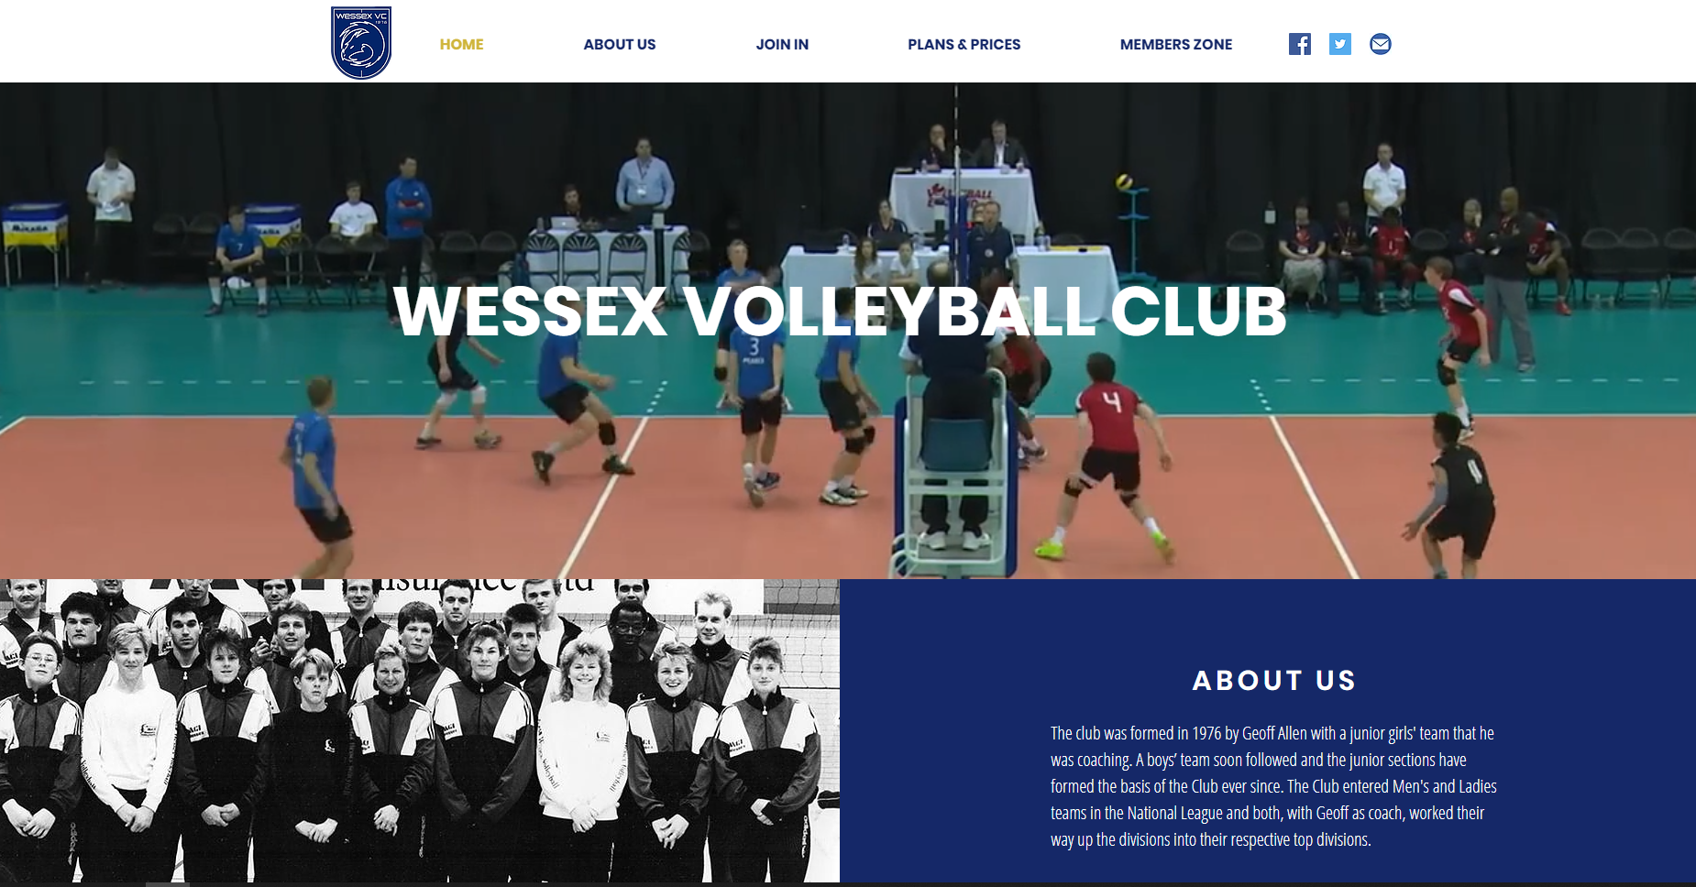
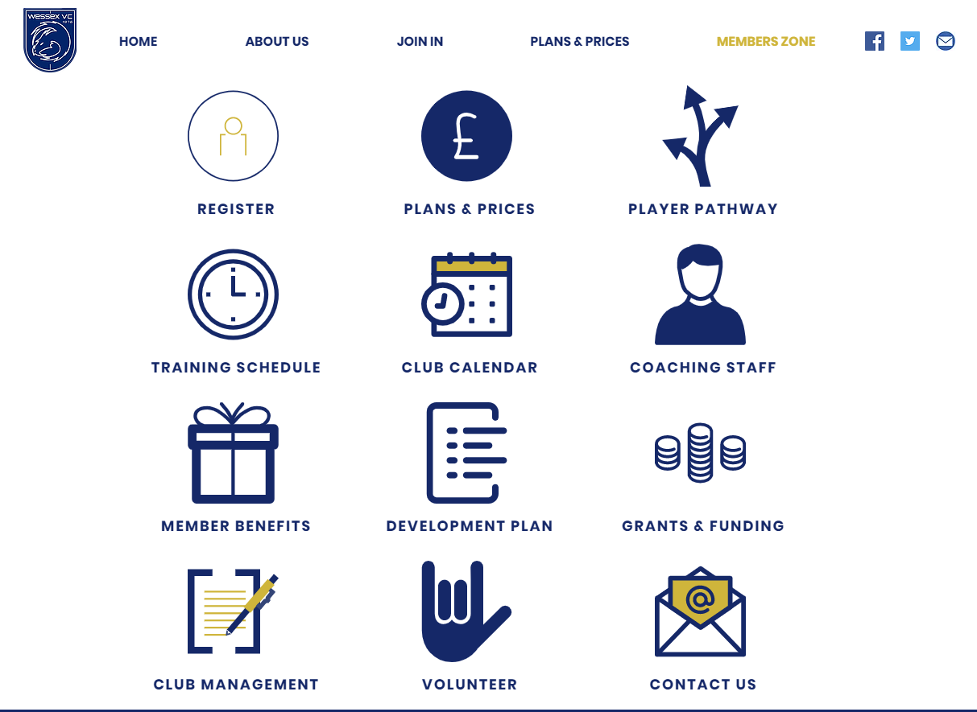
Club Rebrand – New Website
New home page, modern, exciting look to attract new players and partners and google ranking
Members zone that contains all the club information in one easy to navigate place
We will keep this up to date, so please use it and if there is some information missing that you would find useful – let us know!
Notes:
New club logo and nickname
New website launched
Revamped Facebook and Twitter
Kitlocker appointed as kit provider with Nike and unbranded options

Slide 37
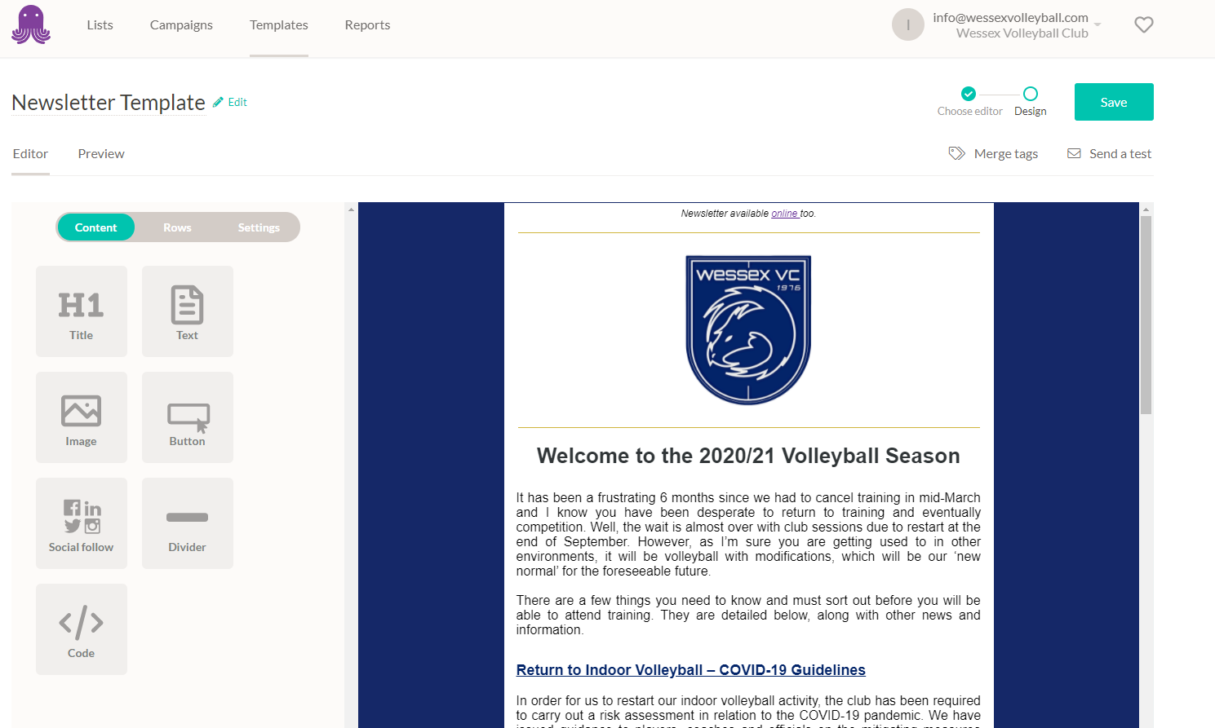
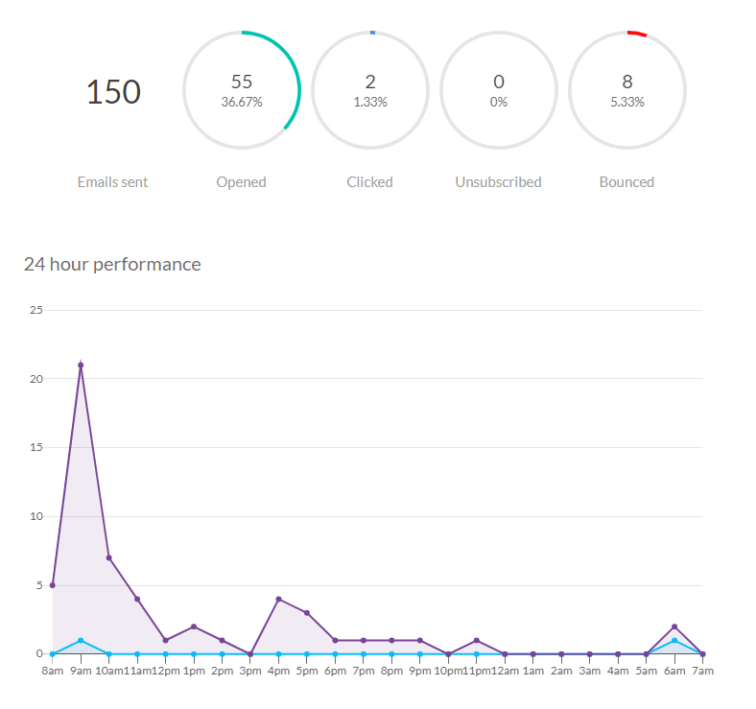
Club Rebrand – New Email System
Easy to curate emails that work across devices
Track engagement with our members and focus on building our subscriber base.
Members can manage their own preferences
Notes:
New club logo and nickname
New website launched
Revamped Facebook and Twitter
Kitlocker appointed as kit provider with Nike and unbranded options

Slide 38
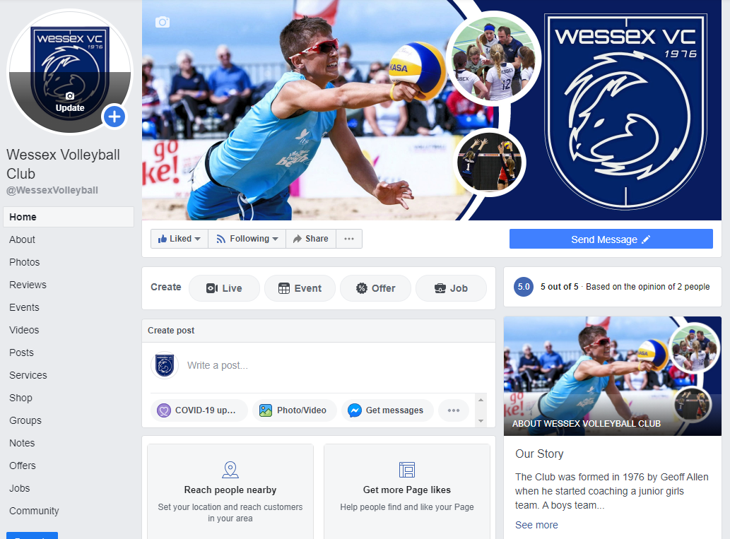
Club Rebrand – Facebook / Twitter
Update banners and logos with new look. Each image is easily interchangeable – please send in high resolution photos!
We still need to improve presence and public communications
Notes:
New club logo and nickname
New website launched
Revamped Facebook and Twitter
Kitlocker appointed as kit provider with Nike and unbranded options

Slide 39
Club Rebrand – Do you have any photos?
Please upload them here:
https://www.wessexvolleyball.com/upload
Notes:
New club logo and nickname
New website launched
Revamped Facebook and Twitter
Kitlocker appointed as kit provider with Nike and unbranded options

Slide 40
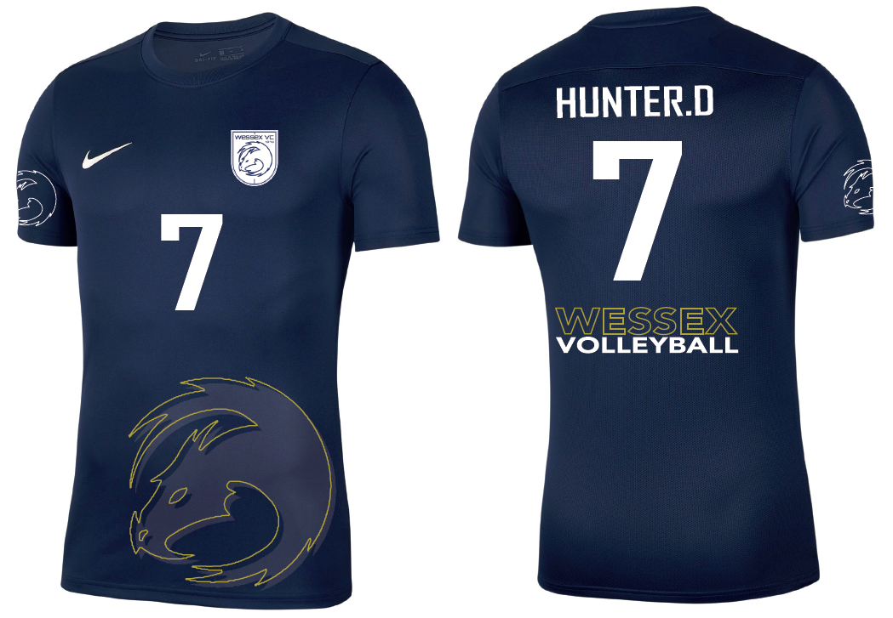
Club Rebrand – New Kit
http://www.wessexvolleyball.com/shop
Notes:
2 phased launch
1 – Match kit, shorts, coaches polo, training tees and unbranded hoody
2 – Jan 2021 – Nike tracksuits, hoodies, coats, bags and other apparel

Slide 41
Club Rebrand – New Kit
http://www.wessexvolleyball.com/shop
Notes:
2 phased launch
1 – Match kit, shorts, coaches polo, training tees and unbranded hoody
2 – Jan 2021 – Nike tracksuits, hoodies, coats, bags and other apparel

Slide 42
Club Rebrand – New Kit
http://www.wessexvolleyball.com/shop
Online soon:
Coat
Hot pants
Water bottles
Large Bag
Jan 2021 (new Nike ranges released):
Club Tracksuit and Bottoms
Branded (Nike) Hoody, full zip hoody and grey alternative
Summer 2021:
Beach Vest (summer 2021)

Slide 43
Thank you
Get involved!

